Slide 1
Synthesis and Physiology of Neurotransmitters
Ishola IO (PhD)
Department of Pharmacology, Therapeutcs and Toxicology
CMUL

Slide 2
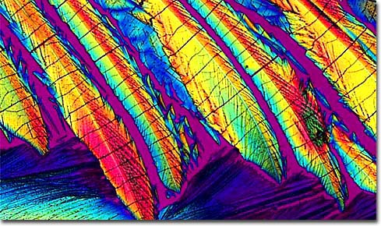
Neurotransmitters
In the 60's, people took acid to make the world weird. Now the world is weird and people take Prozac to make it normal.

Slide 3
Processes Involved in Neurotransmission
Precursors (getting the raw materials)
Biosynthesis (making the NTs)
Storage (vesicles - Golgi bodies)
Transport (neurofilaments and microtubules)
Docking
Influx of Ca⁺⁺
Vesicle movement
Exocytosis— (fusion and release)
Crossing synaptic gap
Binding postsynaptic receptors
Reuptake mechanisms to recover NTs
Deactivation

Slide 4
Neurotransmitter Actions
What is a neurotransmitter?
Under what conditions and how are they released?
What happens to the presynaptic and the postsynaptic neuron once they are released?

Slide 5
The 18th and 19th C debate about the nature of communication in the nervous system: Electrical or Chemical??
After a presynaptic neuron is stimulated the delay is about 0.3 ms for the postsynaptic neuron to respond. This is too long for electric transmission.
If you stimulate the postsynaptic neuron , no response in the presynaptic one. Polarization of communication between neurons.
Stimulation of presynaptic neuron may result in postsynaptic inhibition. Difficult to explain in terms of direct passage of electrical event.
No relationship between the magnitude of the pre and postsynaptic electrical event.

Slide 6
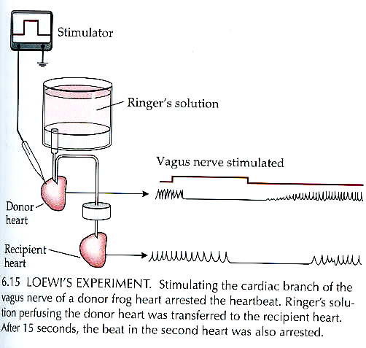
Otto Lowei (1921)
“Vagusstoff” (actually Acetylcholine)

Slide 7
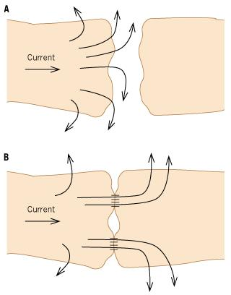
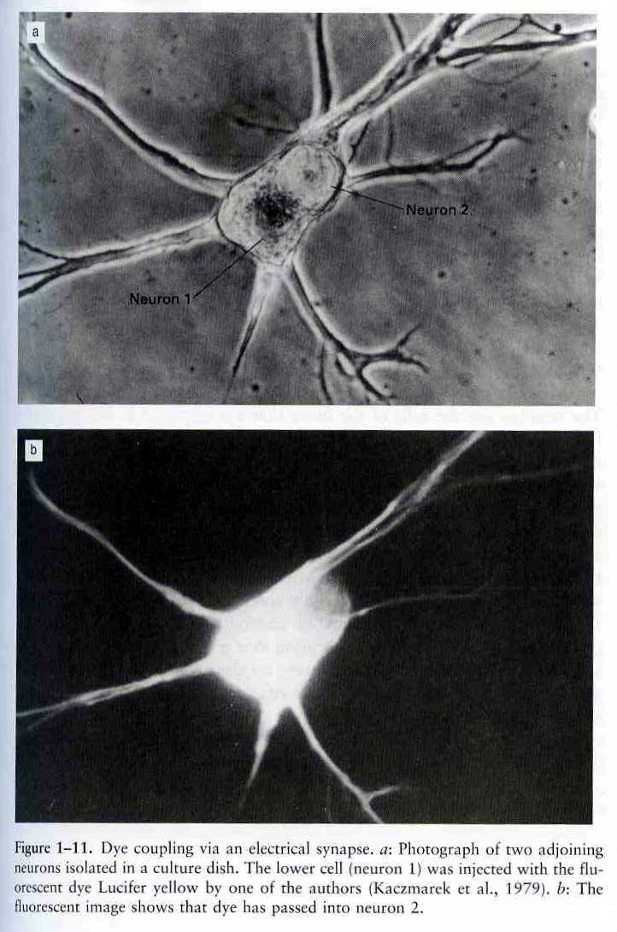
Not to say that there aren’t electrical synapses!!
Gap junctions – cell to cell pores that allow ions and very small molecules to pass from the cytoplasm of one cell to the next.

Slide 8
Before a substance can be called a neurotransmitter:
Presynaptic terminal should contain a store of the substance (preferably in a sequestered form)
Applying the substance to a postsynaptic cell should mimic the effects caused by stimulating the presynaptic terminal
If a drug is known to block a neurotransmitter, it should have the same effect on this transmitter if it’s applied exogenously
A mechanism for the synthesis of this trasmitter must exist (including the appropriate precursors/enzymes in the terminal)
A mechanism for inactivation of the transmitter must exist (catabolic enzymes for its degradation/ reuptake system, etc)

Slide 9
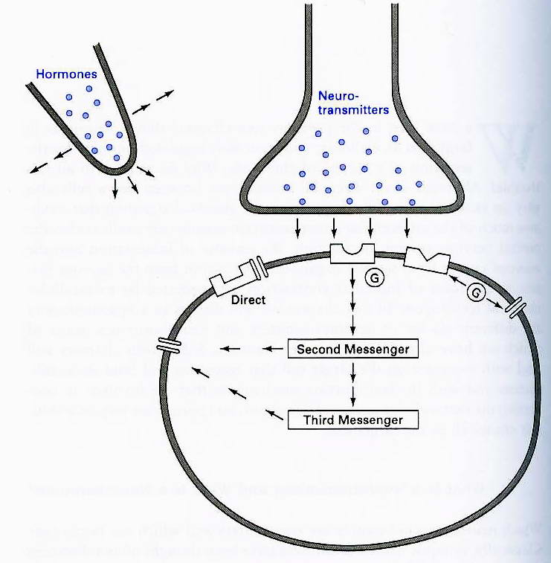
The type of communication between neurons discussed in this class

Slide 10
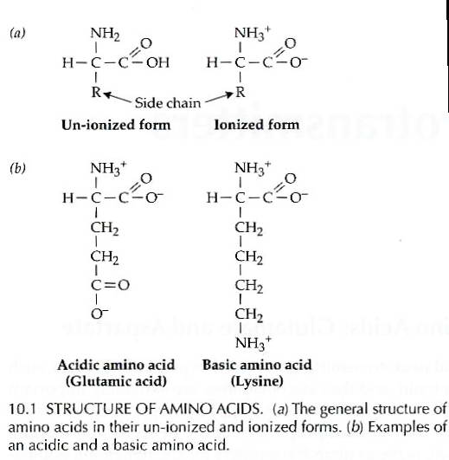
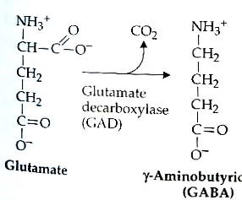
What kinds of neurotransmitters are there?
AMINO ACID transmitters
Glutamate
GABA (γ-aminobutyric acid)
Most transmitters are small, water-soluble molecules containing amine and (in the case of amino acid transmitters) carboxyl groups. These chemical groups cause the transmitters to be ionized at physiological pH and thus reduces the probability of passing the blood-brain-barrier (BBB!).

Slide 11
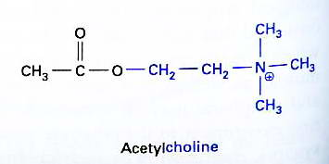
Acetylcholine (Ach)
Present both in the central and peripheral nervous systems (CNS &PNS)
Synthesized by the combination of AcetylCoA, which is a product of the Krebbs cycle in the mitochondria, and choline, which is obtained from food (egg yolk, legumes).
In the PNS, it is the transmitter of the neuromuscular junction- between neurons and all types of muscle (cardiac/smooth/skeletal) and thus is responsible for muscle contraction.

Slide 12
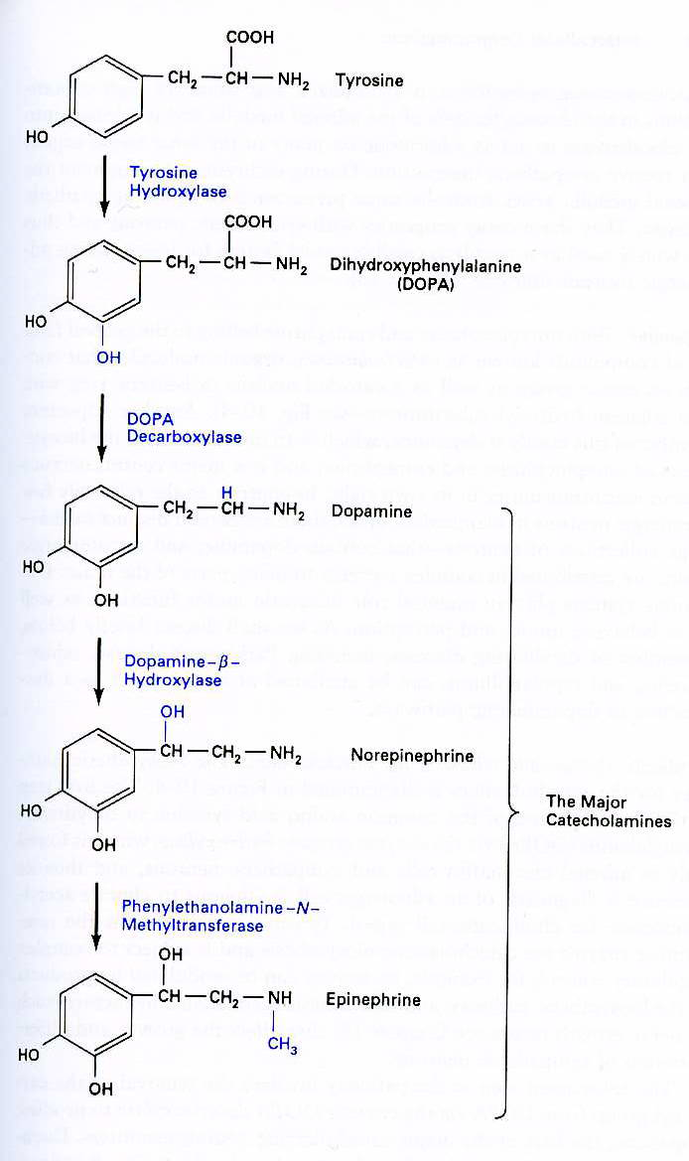
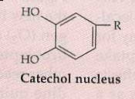
The monoamine neurotransmitters
Dopamine (DA) – concentrated in neurons of the
Ventral Tegmental Area (VTA) and in the
substantia nigra of the basal ganglia. Important
for motion, mood, reward, schizophrenia, etc
NE – first discovered in the sympathetic branch
of the autonomic nervous system. Cell groups
containing NE found in the locus coerulus (LC),
which projects all over the brain and partakes in
The sleep-wake cycle, attention, vigilance.
EPI – sympathoexcitatory, found in the adrenal
medulla and in cell groups of the medulla (oblongata)

Slide 13
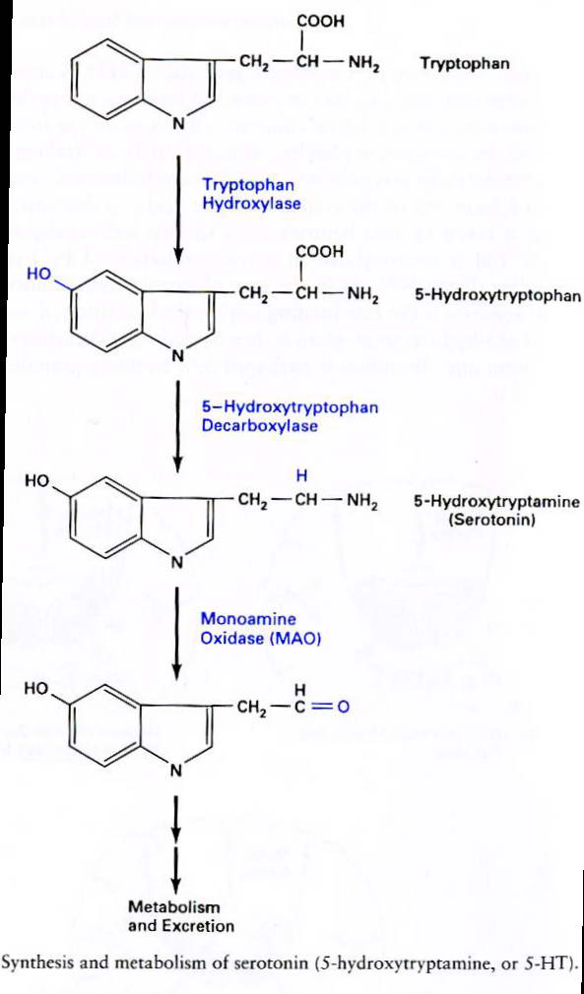
Serotonin (5HT)
First identified as an element found in the blood that aided its clotting and produced vasoconstriction (originating from “serum” + having an effect on muscle “tone” resulted in the name serotonin)
5HT neurons found mostly in the raphe nuclei that are located in the brainstem and that innervate all major brain areas
5HT has been found to be important for food intake, aggression, mood. It is manipulated by antipsychotic drugs. Variations of serotonin (slight changes in its chemical structure) result in hallucinogens such as LSD, ecstasy, mescaline.

Slide 14
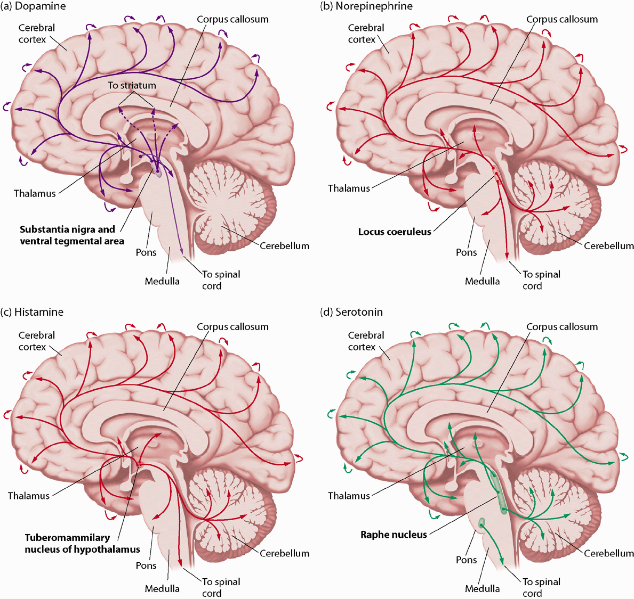
Adapted from Purves D., Augustine, G., and Fitzpatrick, D. (2001). Neuroscience, 2nd edition. Sunderland, MA: Sinaur Associates

Slide 15
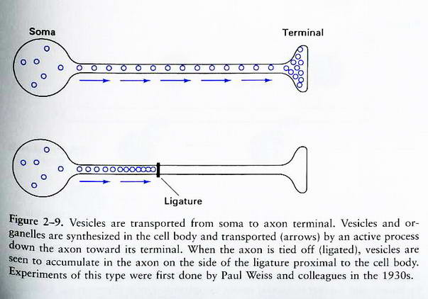
Vesicle transport to the terminal is via microtubules
The synthesis of vesicles occurs in the cell soma, where they pinch off the Golgi apparatus and are transported to the terminal along microtubules in the axon.

Slide 16
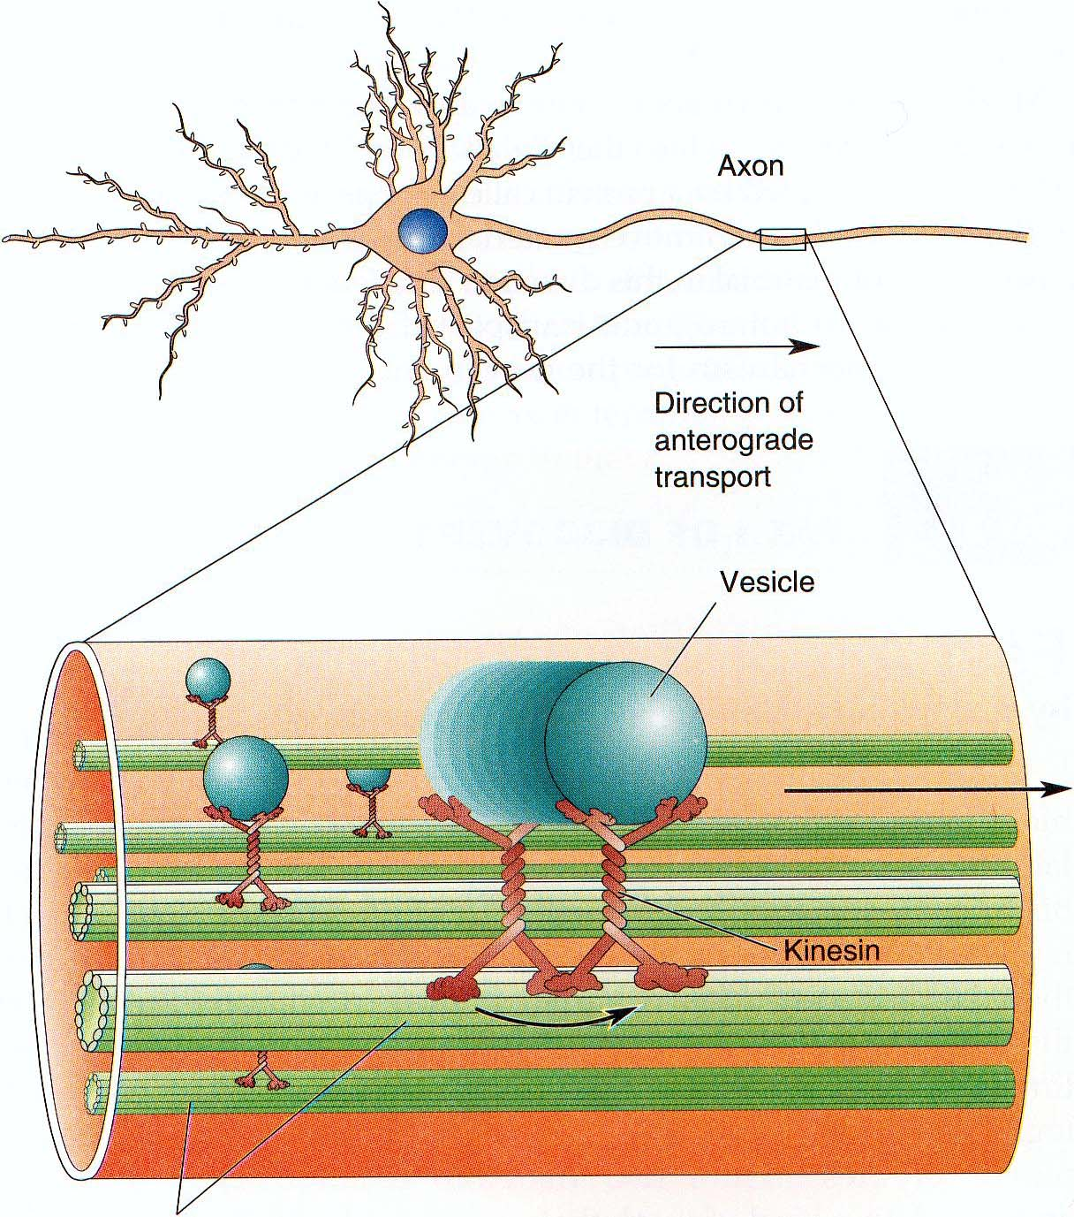
Vesicles are transported to the terminal via an active process
Vesicle transport requires ATP hydrolysis by a small molecular “motor” called kynesin.

Slide 17
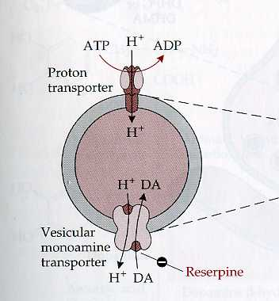
Loading neurotransmitters into vesicles at the terminal
The proton pump hydrolizes ATP and produces a proton gradient and membrane potential across the granule membrane. The amine transporter binds an uncharged amine and couples its transport INTO the vesicle with the H⁺ exit OUT of it. The amine then becomes protonated at the acidic pH of the vesicle and is stuck inside the vesicle.

Slide 18
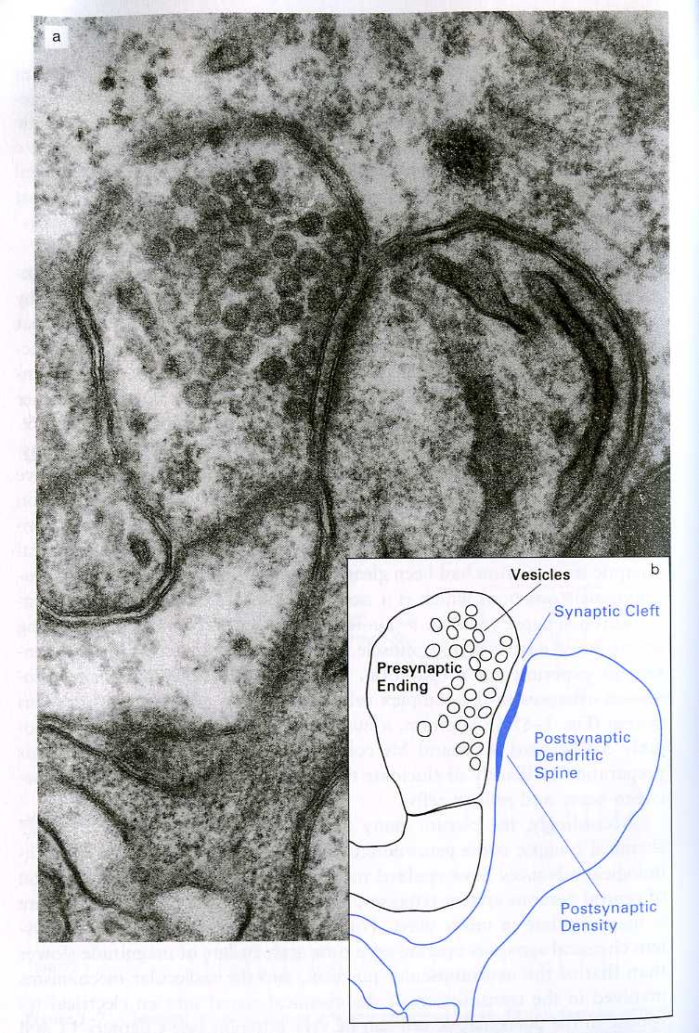
Vesicles aggregate at the presynaptic terminal at the synapse
A synaptic cleft in the CNS separates the pre and postsynaptic terminals by about 20-30 nm
Synapses can be axodendritic, axosomatic and axoaxonic
Active zones- areas of the presynaptic membrane that are sites of vesicle attachment and neurotransmitter release

Slide 19
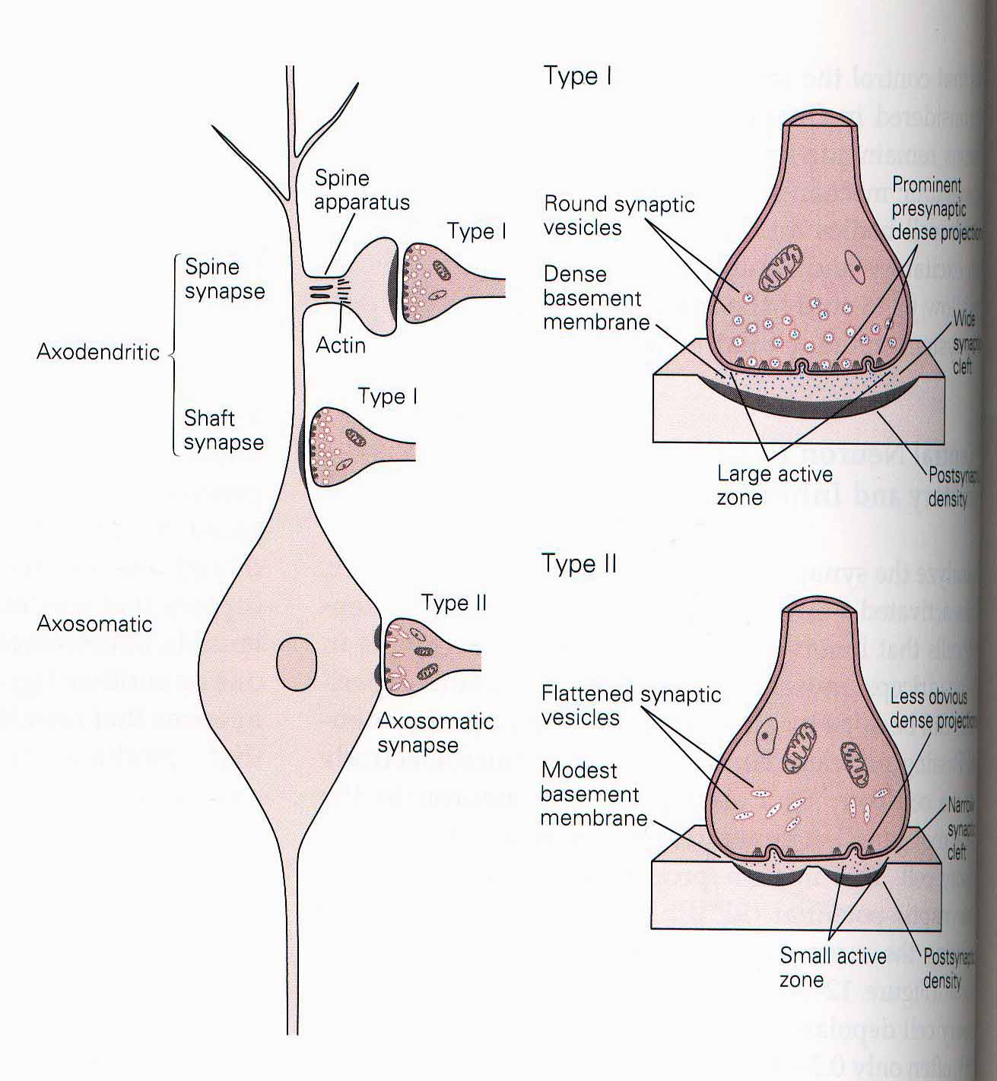
Gray’s Type I and Type II synapse structure
Note the differences in localization of synapses, vesicle shape, the shape of the synaptic cleft.
Type I - usually glutamatergic, excitatory
Type II - usually GABAergic, inhibitory

Slide 20
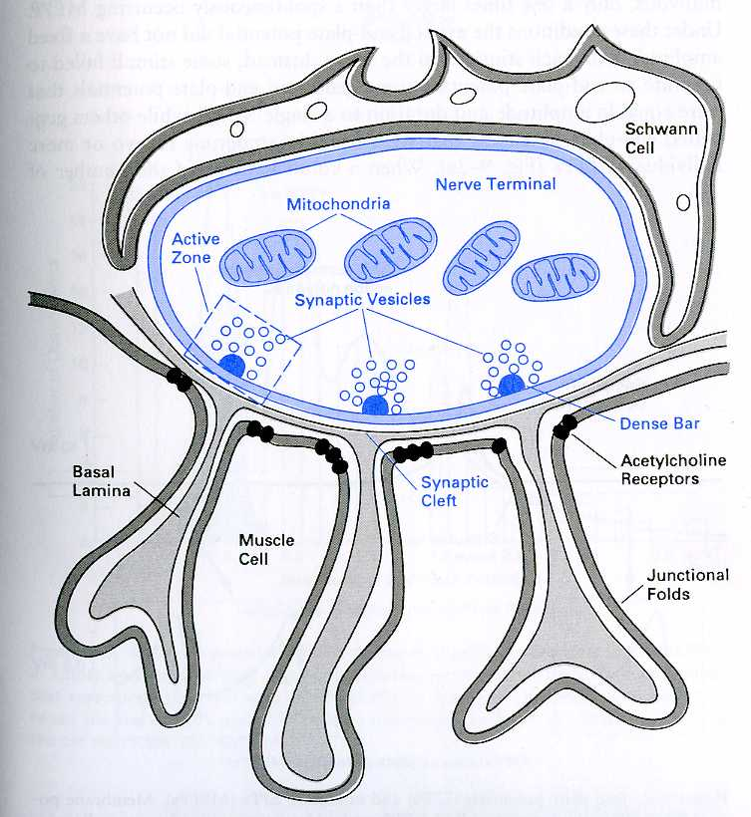
The structure of the neuromuscular junction (NMJ) in the PNS
The junctional folds found on the postsynaptic side of the NMJ increase the number of Ach receptors that are exposed to release of neurotransmitter, resulting in very efficient transmission

Slide 21
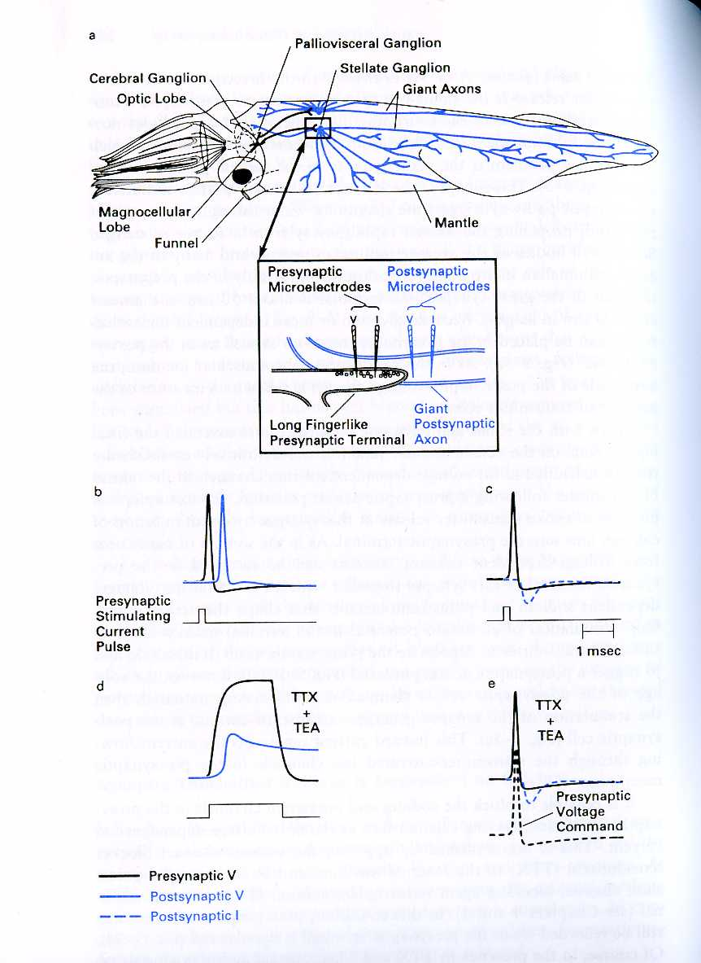
Neurotransmitter Release is Ca++ dependent
Release of neurotransmitters is dependent upon the entry of Ca⁺⁺ into the presynaptic terminal through voltage sensitive Ca⁺⁺ channels, which are clustered near release sites.
Voltage increases sufficient to open Ca⁺⁺ channels usually occurs with the arrival of an action potential to the terminal. The terminal can also be stimulated with an electrode to increase voltage.
TTX blocks Na⁺ channels
TEA blocks K⁺ channels

Slide 22
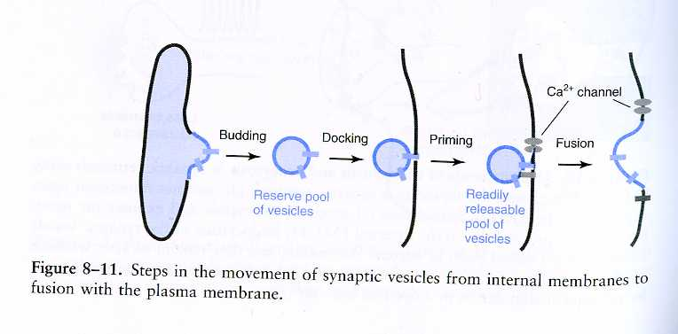
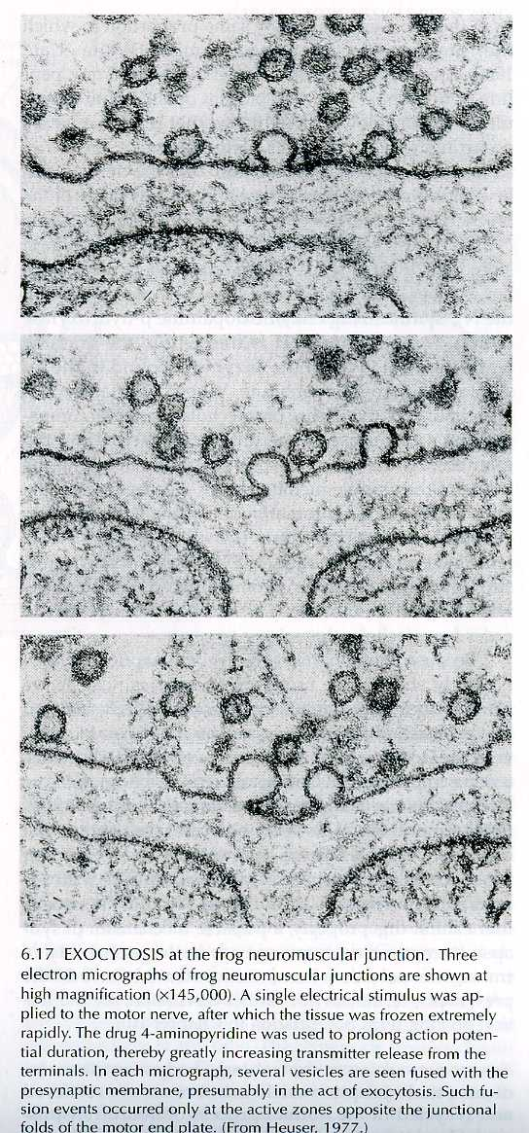
Vesicle Exocytosis
The time between docking and exocytosis is less than 200 ms. In order for vesicles to dock and to be primed for release, ATP is necessary. Thus mitochondria are present at the terminal.

Slide 23
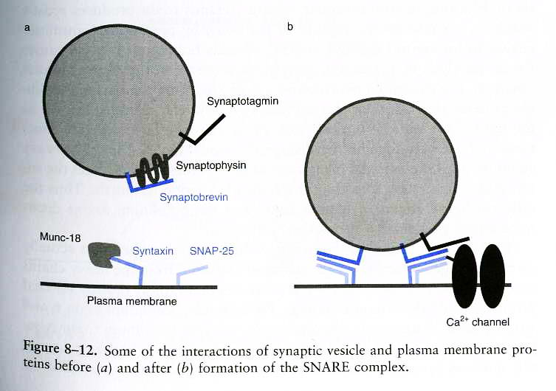
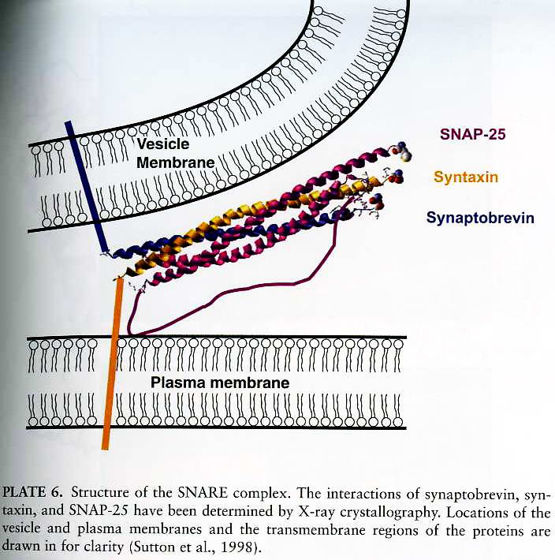
The SNARE complex model of vesicular fusion
As vesicles fuse with the membrane the SNARE complex forms as a result of the close association of proteins found on the membranes of the vesicle and plasma membrane.
Toxins, such as botulinum toxin and tetanus toxin, selectively cleave different proteins of the SNARE complex, preventing vesicle fusion and neurotransmitter release, thus causing paralysis. (Botox is also used in plastic surgeries to eliminate wrinkles of the forehead.)

Slide 24
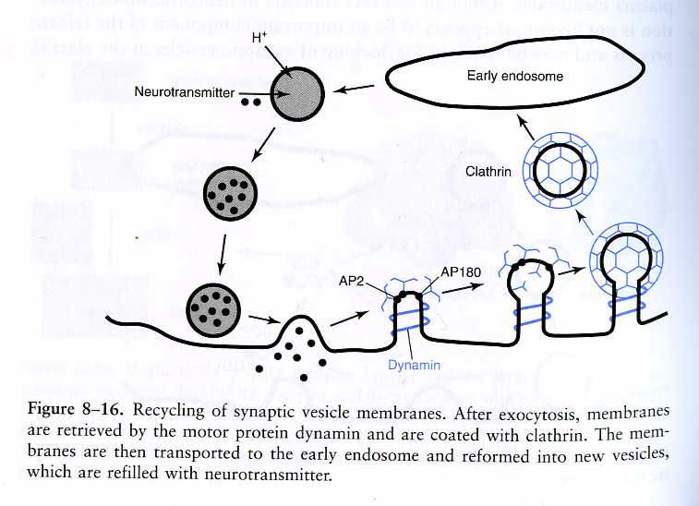
Vesicle endocytosis and recycling
After neurotransmitter release, the vesicular membrane is coated with the protein clathring, thus identifying it for recycling. The clathrin coated pits are transferred to the endosome, where the membrane is reused for new vesicles and refilled with neurotranmitter.

Slide 25
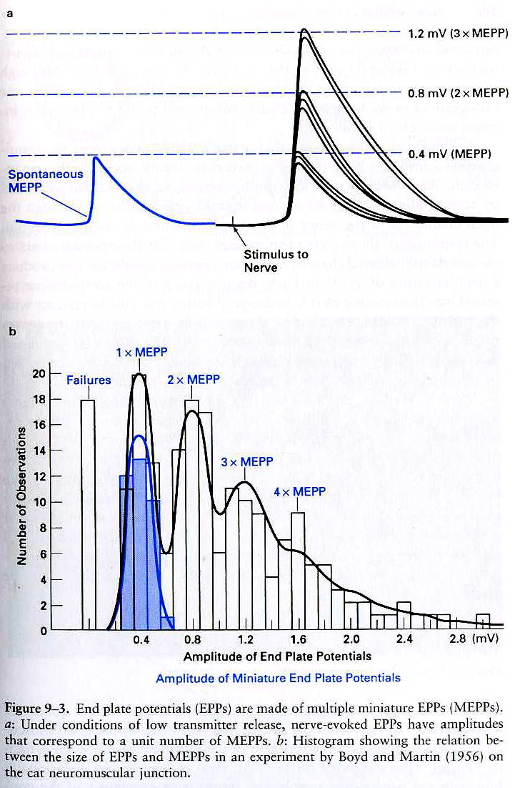
Neurotransmitters are released in “quanta”
Spontaneous miniature end plate potentials (MEPPs) are usually about 0.5mV. Stimulation of the presynaptic terminal causes post-synaptic end plate potential (EPP) amplitudes to be at multiples of the MEPP. With iontophoretic application of Ach, it was estimated that about 5000 molecules (or a quantum) of Ach are released synchronously into the synaptic cleft to generate a single MEPP.
1950s, Katz et al., suggested that the packets of quanta of Ach correspond to neurotransmitter content of a single vesicle

Slide 26
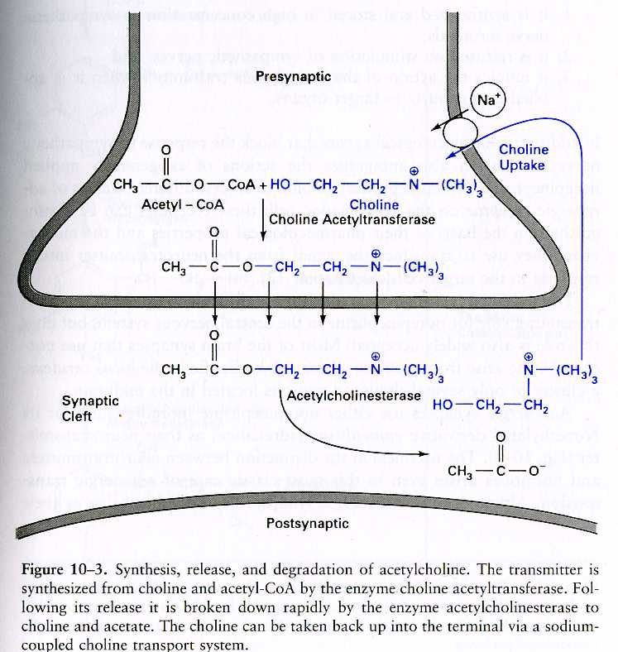
Removal of the neurotransmitter from the synaptic cleft
Timely removal prevents desensitization of receptors and interference with new incoming signals.
Mechanisms
Enzymatic degradation: Acetylcholinesterase
A nearly 100% efficient enzyme. Ach molecules are hydrolized as rapidly as they can diffuse into the active site. Forms acetate and choline.
Breaks down 14,000 Ach mols/sec (1 moleucle in 70 µsec)

Slide 27
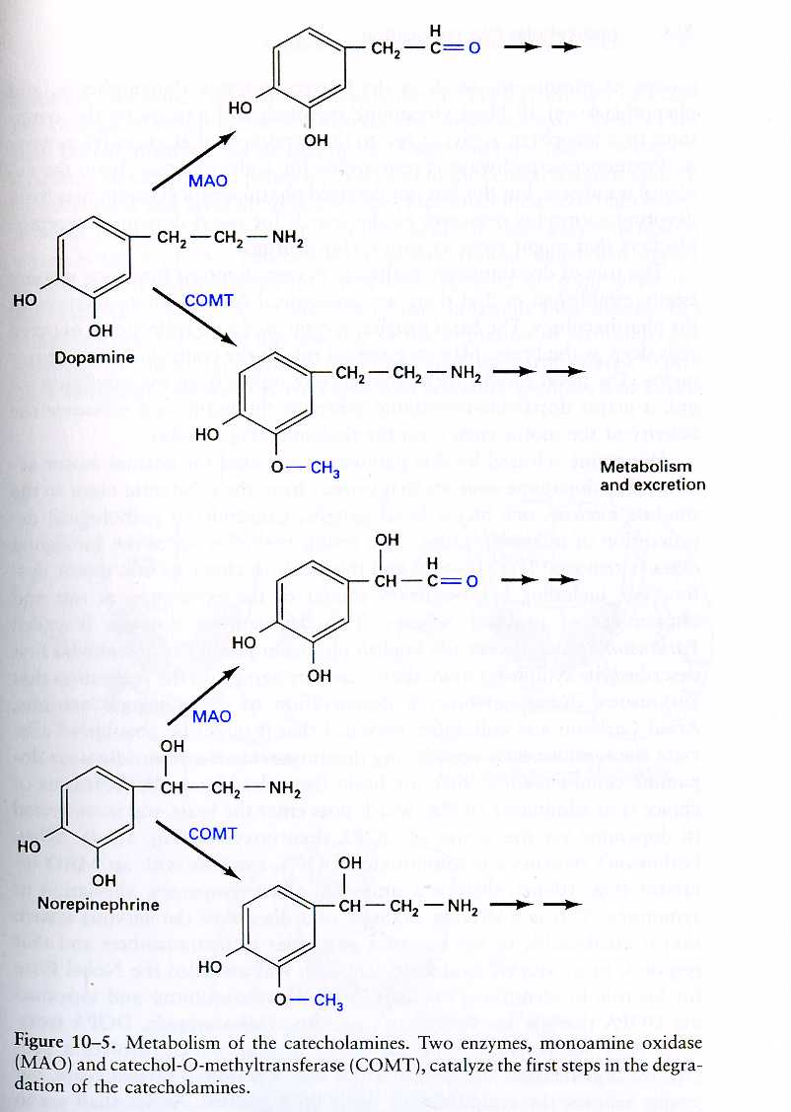
Degradation of Catecholamines
Monoamine Oxidase (MAO) – an enzyme that catalyzes the neurotransmitter to its corresponding aldehyde. This form can be broken down further and excreted. MAO is located in the mitochondria of catecholaminergic terminals.
Catechol-O-Methyl-Transferase (COMT) – methylates a hydroxyl group of the catechol nucleus. The products can then also be excreted.
Antidepressant drugs act on these enzymes. E.g. Pargyline – a clinically effective antidepressant is an MAO inhibitor, increases DA levels in the CNS.

Slide 28
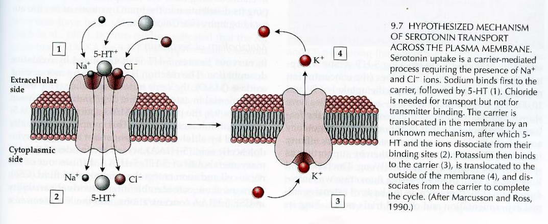
The most common mechanism: Reuptake by transporter molecules
Transporter molecules are in the presynaptic nerve terminals and glial cells
Transporter molecules have binding constants of <25 mM.
serotonin
norepinephrine
Dopamine cocaine and amphetamine prevent reuptake of DA and NE
glutamate
GABA
glycine
choline (after acetylcholine is broken down, choline is taken into the
presynaptic nerve terminal for reuse)

Slide 29
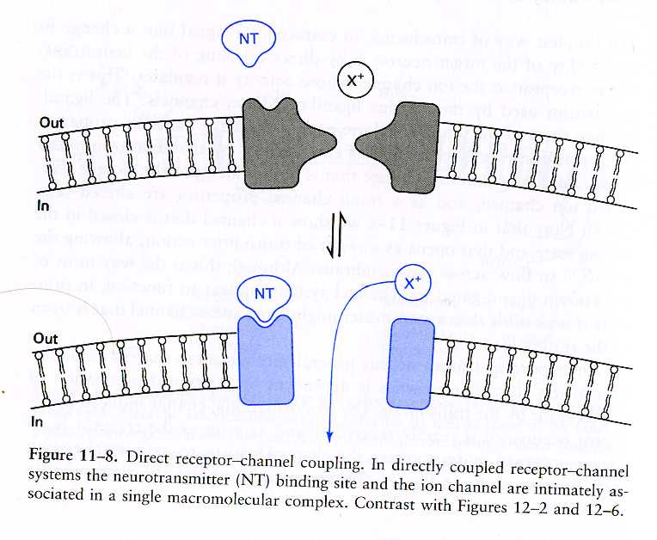
Postsynaptic actions of neurotransmitters are receptor dependent
Ligand-gated ion channels – activated by the biding of a neurotransmitter
Binding of the ligand stabilizes the active conformation of the receptor, thereby opening an ion channel, which is created by the arrangement of four to five receptor subunits.
e.g. Nicotinic receptor for Ach

Slide 30
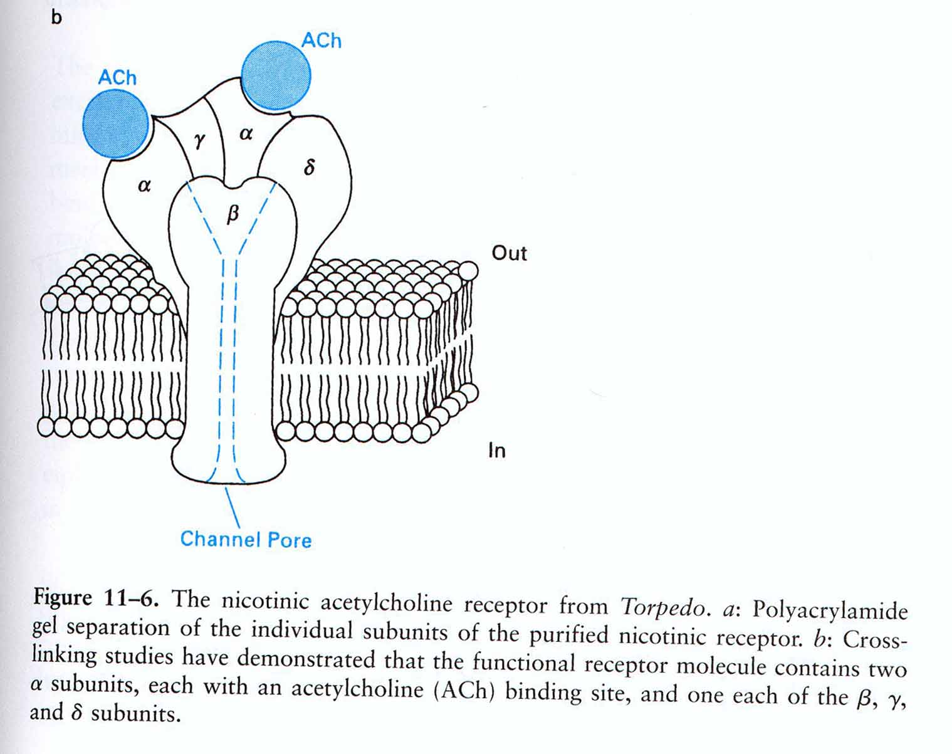
An example of a ligand gated ion channel
The nicotinic Ach receptor. It needs two molecules of Ach in order to open. It is permeable to cations. It is found in the NMJ, autonomic ganglia, hippocampus, thalamus, etc.

Slide 31
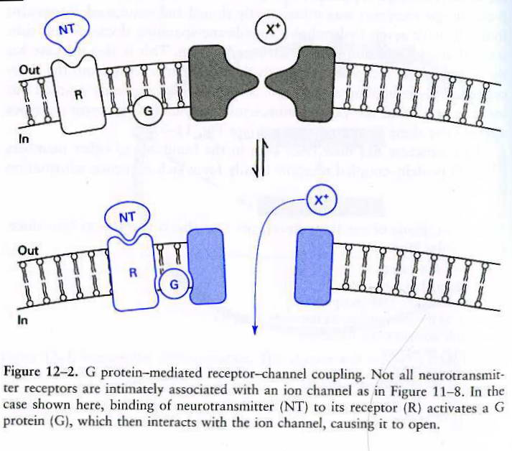
G-protein mediated receptors
G-protein is a guanyl nucleotide-binding protein. In its inactive state it has a GDP bound to it, whereas in its active state it has a GTP bound to it. In its active state, the protein can interact with an effector system (such as an ion channel)

Slide 32
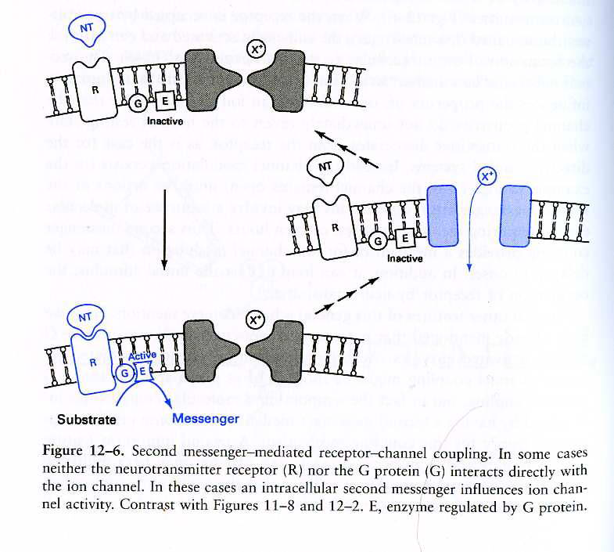
Second messenger systems
The G protein activates a second messenger which then activates any number of other mechanisms inside the cell, which can alter the intracellular calcium concentration, open/close channels, alter gene production

Slide 33
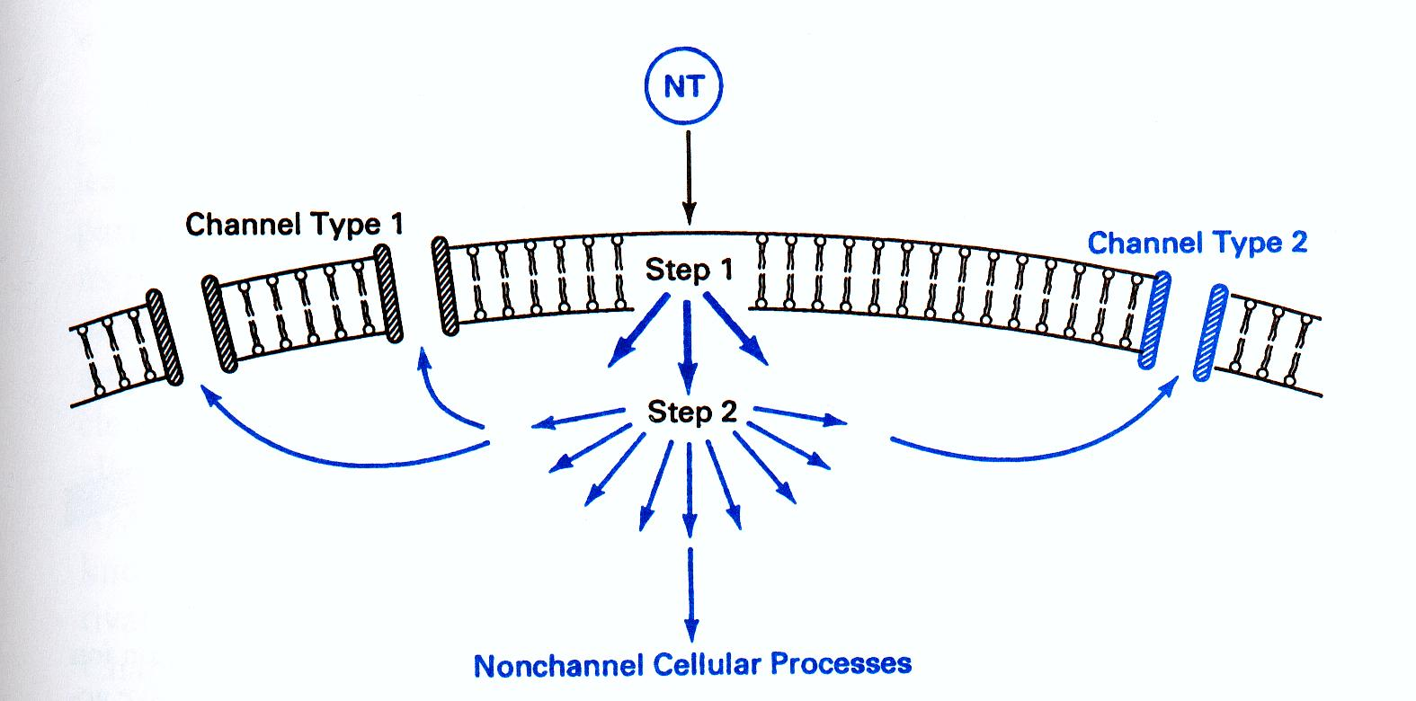
Amplification of second messenger message

Slide 34
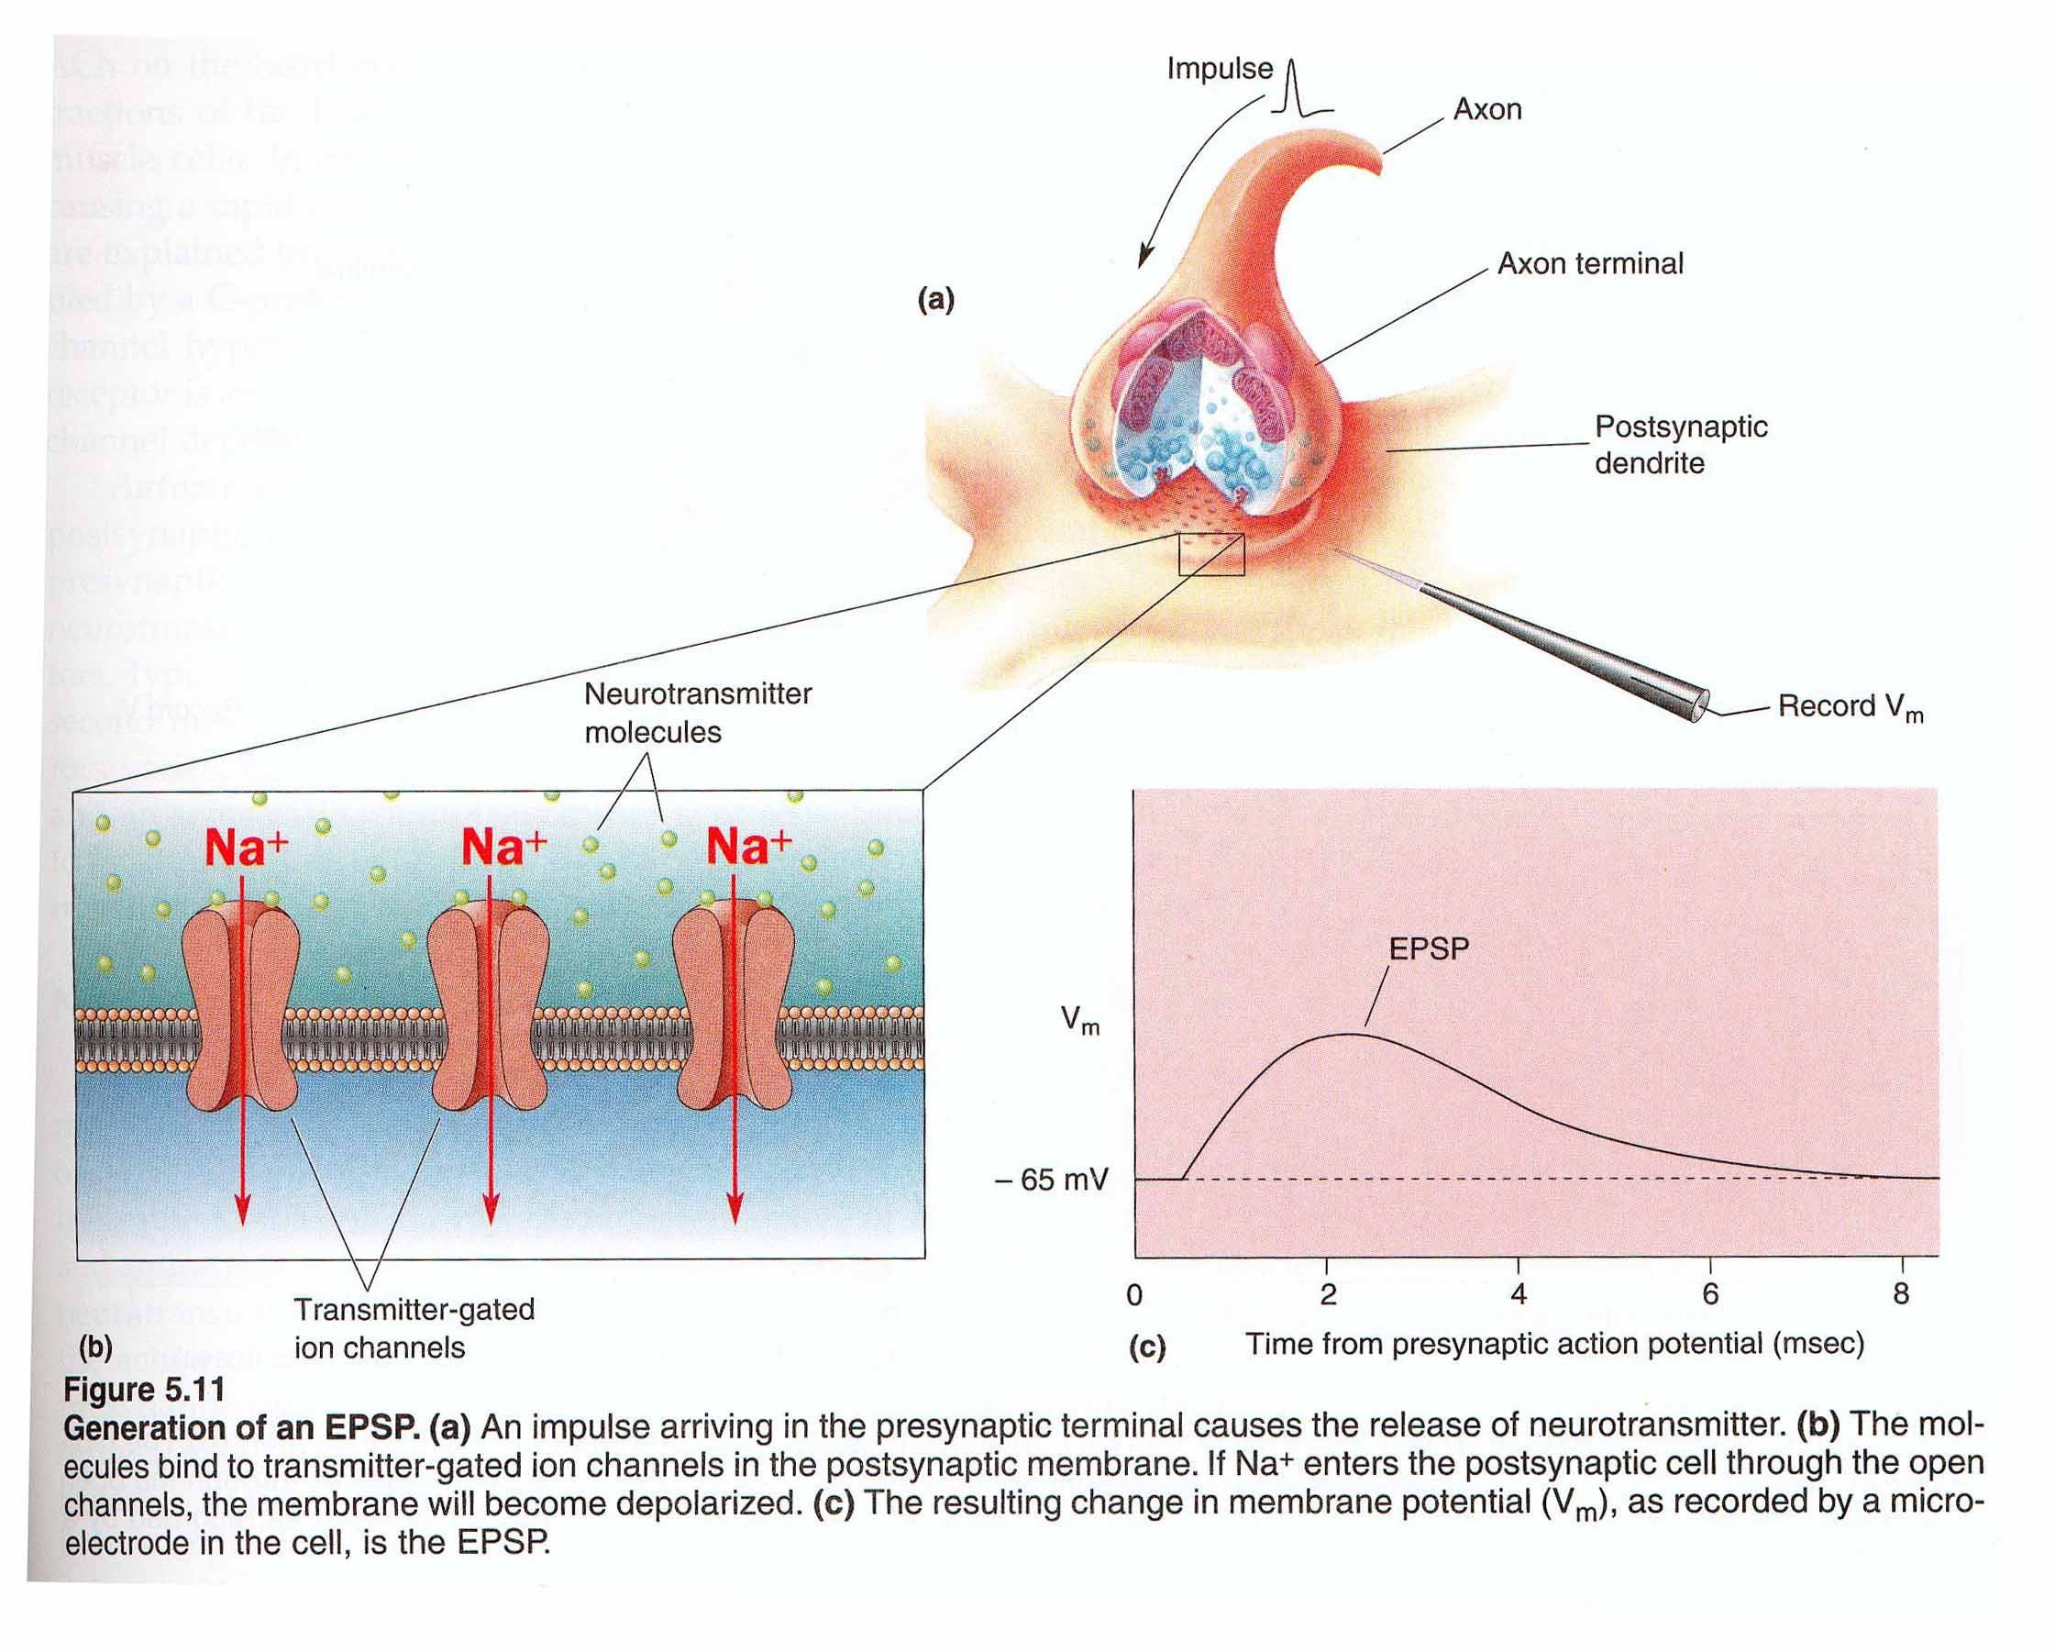
The postsynaptic EPSP
When the channel opens, both Na+ and K+ can flow through the channel. Based on the resting membrane potential (near -70 mV) and the equilibrium potentials for each ion, we can see that there is a tremendous potential difference for Na+, yet a very small differential for K+. As a result, at rest, acetylcholine triggers a rapid influx of Na+. This influx of Na+ leads to an excitatory postsynaptic potential

Slide 35
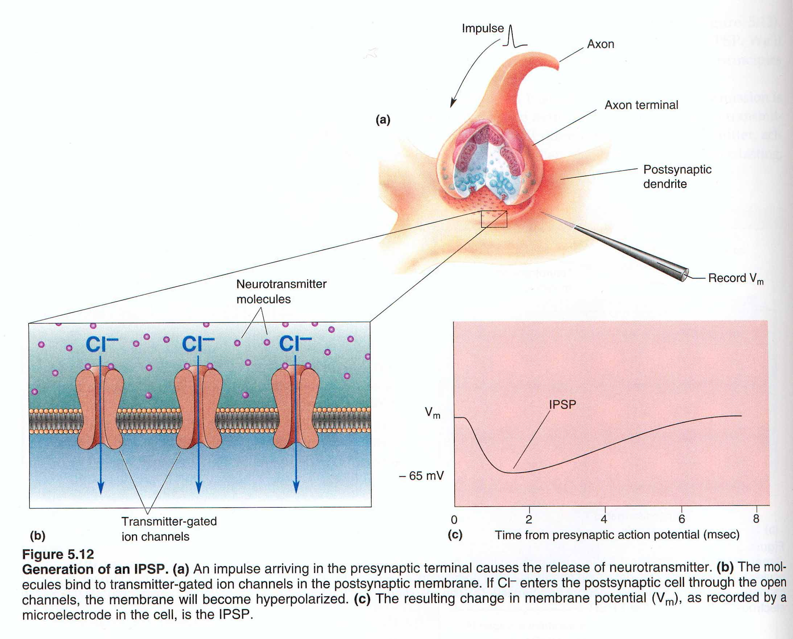
The postsynaptic IPSP
An inhibitory postsynaptic potential is often mediated by the opening of chloride channels which cause an influx of Cl- into the cell

Slide 36
Modifying Mood and Easing Anxiety
Mood as predominant emotional state of an individual over time
- Antidepressant drug treatments
Emotion as transient response to environmental, interoceptive, or cognitive stimuli. Anxiety versus fear.
- Anxiolytic drug treatments

Slide 37
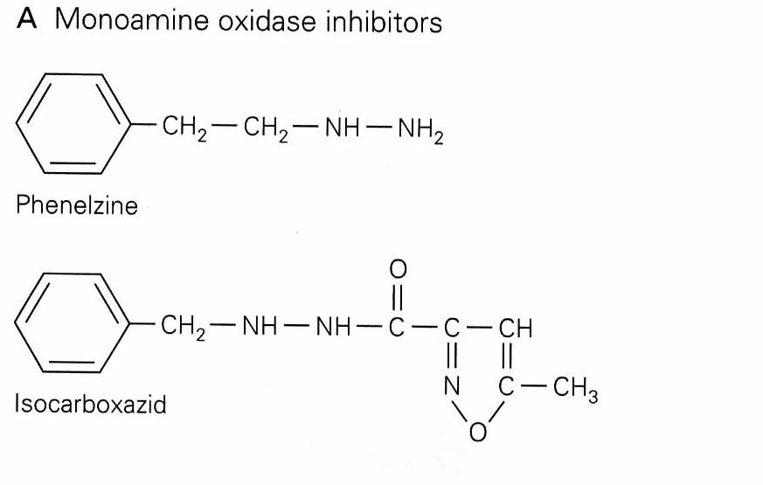
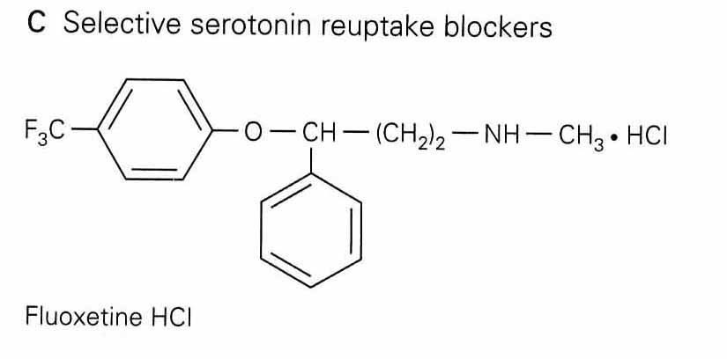
First Antideptressants - MAO Inhibitors
Monoamine depletion model of depression (1960s)
Mice given reserpine showed decreased locomotor activity, which was reversed by administration of MAO inhibitors (such as pargyline)
Monoamine Uptake inhibitors (imipramine) also proved useful for treatment of depression, suggesting a presynaptic mode of action

Slide 38
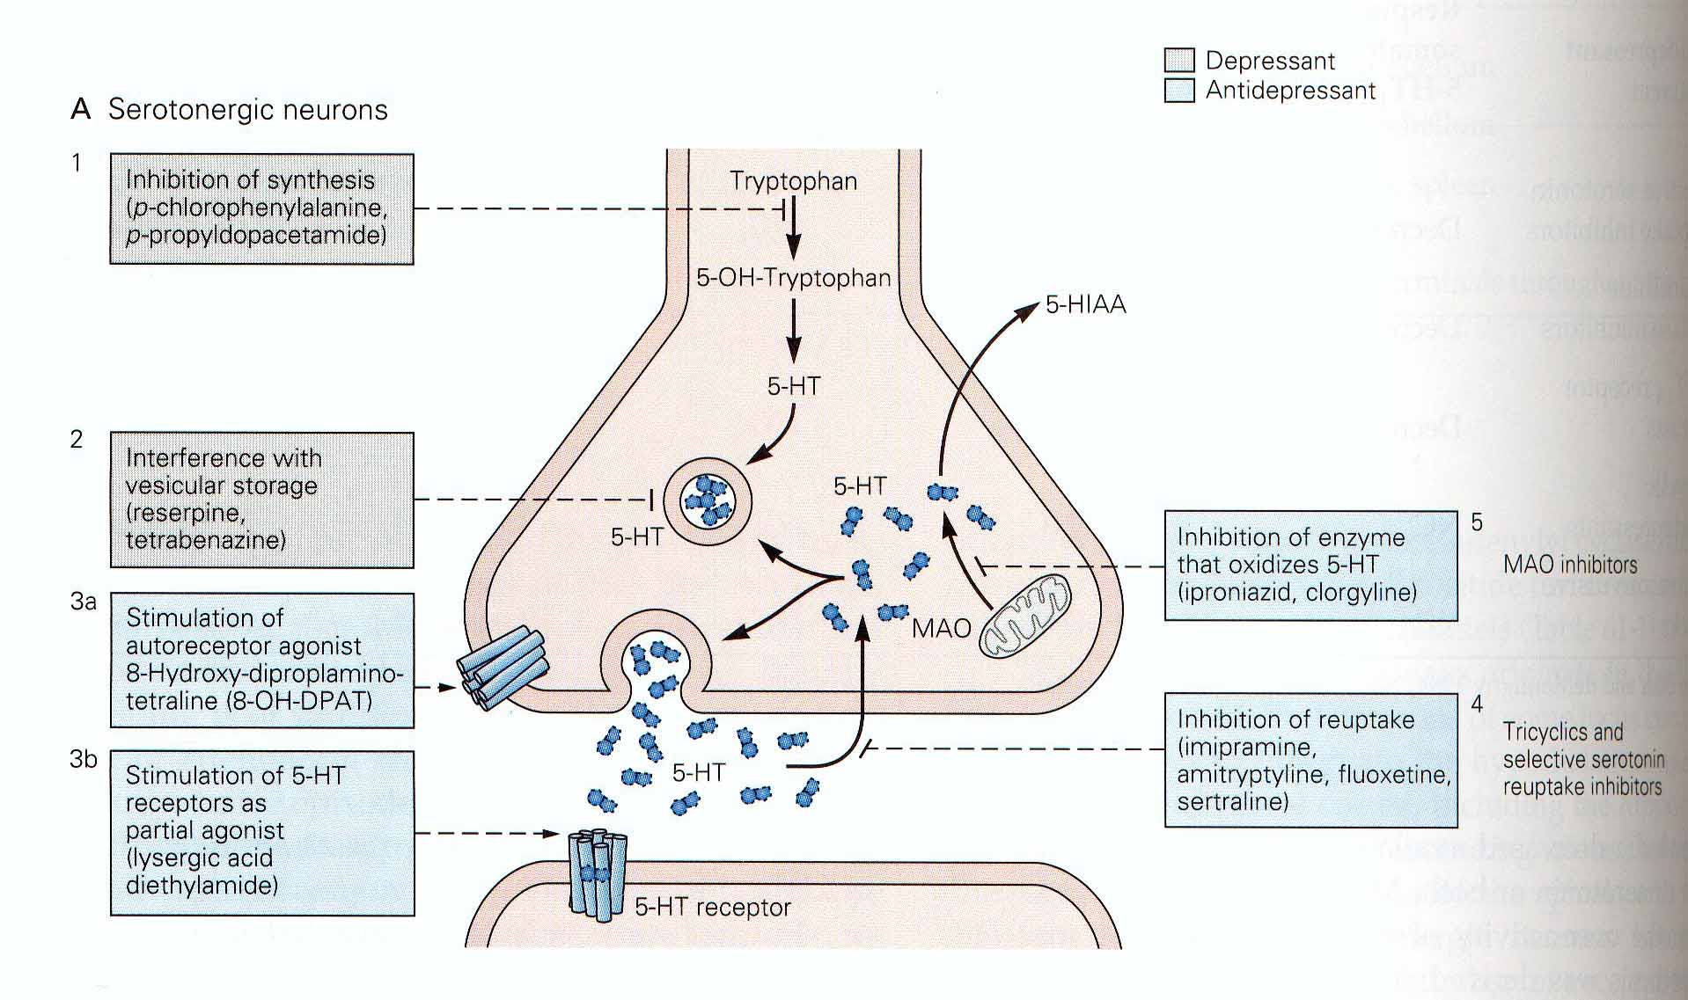
Action of antidepressants and other drugs at serotonergic synapses
SSRI- selective serotonin reuptake inhibitors

Slide 39
The Lag Time Enigma and Antidpressant Action
A substantial lag between the time an antidepressant is administered and relief of symptoms, suggested that changes occur post and not presynaptically.
Prompted the hypothesis that pathogenesis and treatment of depression involves a plasticity/adaptation in relevant neuronal pathways.
The current model suggests second messenger systems that upregulate postsynaptic signaling cascades and result in an increased production of BDNF (brain derived neurotrophic factor)

Slide 40
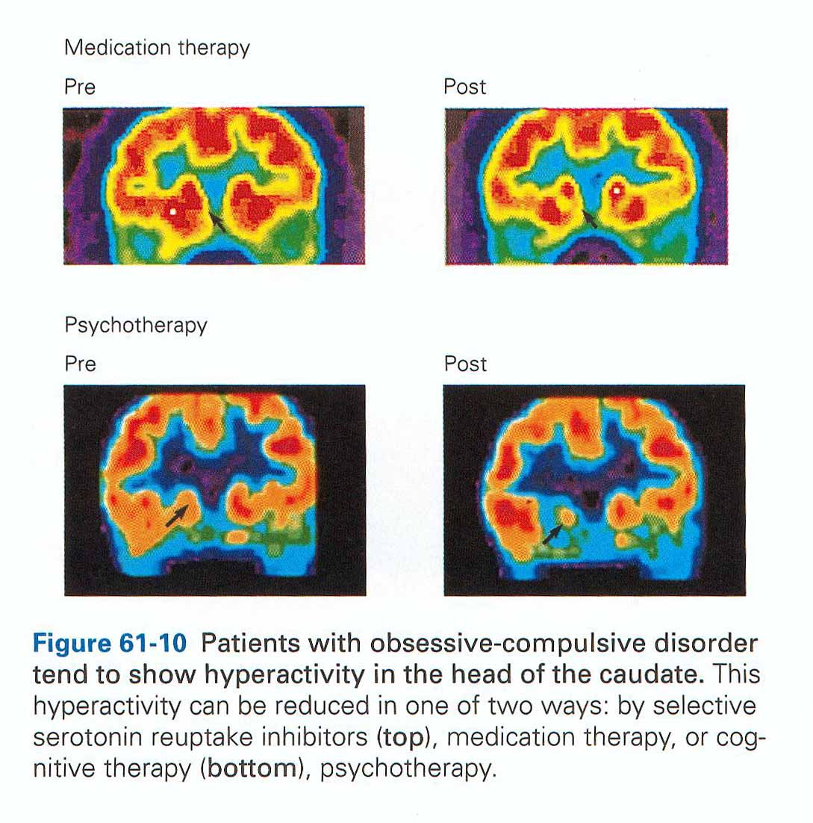
Psychotherapy and Medication can result in the same thing!!

Slide 41
Pharmacotherapy of Anxiety
“Because I associated the attacks with driving, I reduced my driving to pure necessity. Eventually because I feared another attack and the consequent embarrassment, I avoided all but essential social contact. Ultimately I was frightened to leave my own home.”
An estimated 19 million Americans suffer from anxiety disorders (AADA - Anxiety Disorders Association of America)
Benzodiazepines: Acute anxiety, generalized anxiety disorder (GAD), panic
Antidepressants: Generalized anxiety disorder, panic, obsessive compulsive disorder

Slide 42
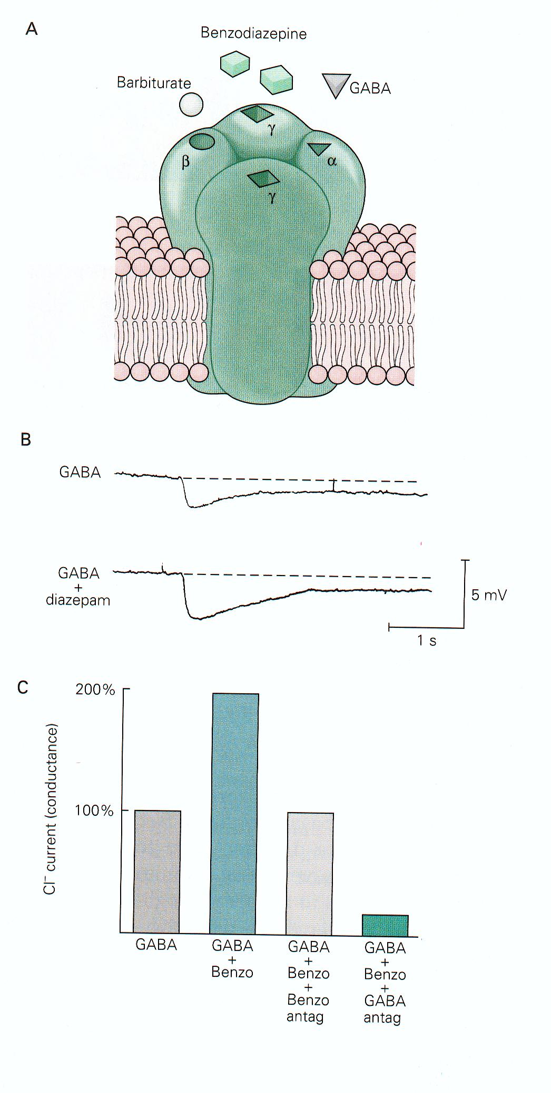
Pharmacotherapy of Anxiety
Diazepam - a benzodiazepine that is effective at treating GAD
Works via the GABAa channel (permeable to Cl-). It increases the affinity of GABA for the receptor, thus increasing the Cl- conductance and the hyperpolarizing current.
High concentrations of GABA receptors are found in the limbic system (“the emotional system”)

Slide 43
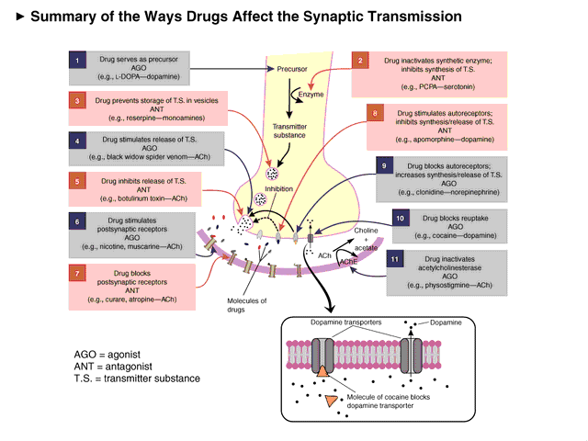

Slide 44
Categories of NTs
Amino Acids
Glutamate (Glu)
GABA
Biogenic Amines
Quaternary Amines
Acetylcholine (Ach)
Monoamines
Catecholamines
Dopamine (DA)
Norepinephrine (NE)
Indolamines
Serotonin (5-HT)
Neuropeptides
Opioid Peptides
Enkephalins
Endorphins
Dynorphins
Others (e.g. lipids, nucleosides)

Slide 45
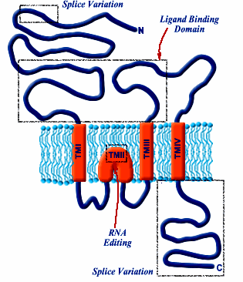
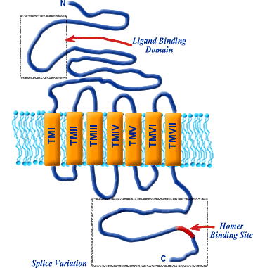
Receptors
Genetically-coded proteins embedded in cell membrane
Gating
Ligand-gated - Stretch-gated
Voltage-gated
Effects
Ionotropic
Metabotropic
Location
Postsynaptic
Presynaptic
Heteroreceptor
Autoreceptor
ionotropic
metabotropic

Slide 46
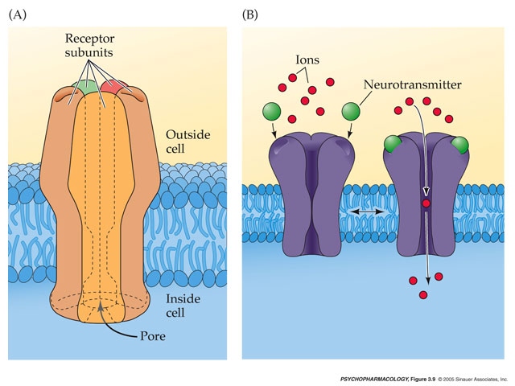
Ionotropic Receptors
Work very fast; important role in fast neurotransmission
Each is made of several subunits (together form the complete receptor)
At center of receptors is channel or pore to allow flow of neurotransmitter
At rest - receptor channels is closed
When neurotransmitter bind -- channel immediately opens
When ligand leaves binding site -- channel quickly closes

Slide 47
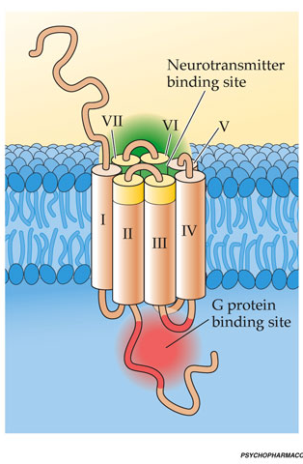
Metabotropic Receptors
Work more slowly than ionotropic receptors
Though it takes longer for postsynapic cell to respond, response is somewhat longer-lasting
Comprise a single protein subunit, winding back-and-forth through cell membrane seven times (transmembrane domains)
They do not possess a channel or pore

Slide 48
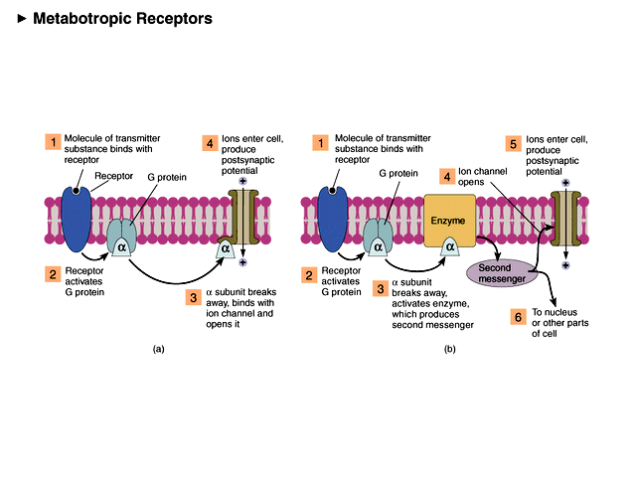

Slide 49
Theory of Drug Action
Emil Fischer’s ‘Lock and Key’ Hypothesis (1890)
Every ‘lock’ has its own ‘key’
If the ‘key’ is not precise, the ‘lock’ does not open
The ‘drug’ is the key that has to fit the target specifically and productively

Slide 50
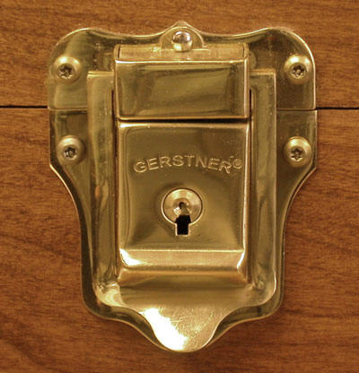
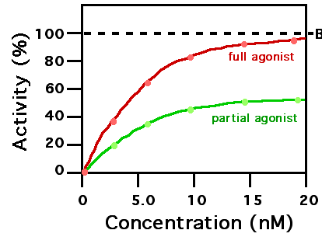
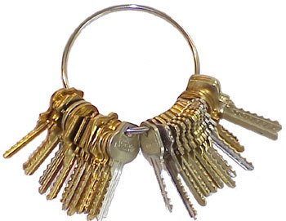
Theory of Drug Action
Corollary of ‘Lock & Key’ Hypothesis
Does not explain why some ‘keys’ open doors partially? …… e.g., partial agonists or antagonists
Notes:
A partial agonist will have finite affinity for both conformational states(active and inactive) of the receptor (i.e., it is both an agonist and an antagonist), although it will be higher for the active conformation.

Slide 51
Theory of Drug Action
Daniel Koshland’s ‘Induced-Fit’ Hypothesis (1958)
At least two steps …… step 1 is initial binding and step 2 is a change in structure of the receptor (and/or drug)
Receptor is flexible! …… can wrap around the drug

Slide 52
Common Neurotransmitters Involved in Dependence
Probable functional dysregulation:
Dopamine (DA)
Serotonin (SER)
Acetylcholine (ACh)
Endorphins (END)
Gamma-aminobutyric acid (GABA)
Glutamate (GLU)

Slide 53
Drugs Associated with Neurotransmitters
Why do people have “drugs of choice”?
• Dopamine - amphetamines, cocaine, ETOH
• Serotonin - LSD, ETOH
• Endorphins - opioids, ETOH
• GABA - benzodiazepines, ETOH
• Glutamate –ETOH
• Acetylcholine - nicotine, ETOH
Anandamide – Marijuana

Slide 54
Amino Acid NTs
High concentration in brain (micromolar)
Circuits
Cortico-cortical
Sensory-motor
Point-to-point communication
Consistently excitatory or inhibitory
Mainly ionotropic receptors but do have metabotropic receptors
Fast acting, short duration (1-5 ms)
Examples: Glutamate, Aspartate, GABA, Glycine

Slide 55
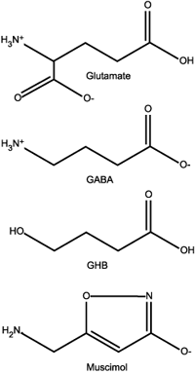
GABA and Glutamate
.
Because they are structurally very similar, various drugs affect the presence of GLU and GABA in the synaptic gap and increase or decrease action potentials.

Slide 56

Glutamate
Principal excitatory NT
Biosynthesized as byproduct of cell metabolism
Removed by reuptake
Elevated levels → neurotoxic
4 receptor types
NMDA
AMPA
Kainate
mGluR - Metabotropic
Ionotropic

Slide 57

NMDA Binding Sites
“The specific subunit composition of each receptor determines its overall pharmacological properties”
4 outside cell
Glutamate
Glycine
Obligatory co-agonist
Inhibitory NT at its “own” receptor
Zinc (inverse agonist)
Polyamine (indirect agonist)
2 inside cell
Magnesium (inverse agonist)
PCP (inverse agonist)

Slide 58

GABA (Gamma Aminobutyric Acid)
Principal Inhibitory NT
Biosynthesis:
Glu
GABA
Glutamic Acid
Decarboxylase (GAD) and B6
Removed by reuptake
2 receptor types
GABA_{A} GABA_{C} (ionotropic; Cl⁻ channel)
GABA_{B} (metabotropic; K+ channel)

Slide 59

GABAa Binding Sites
GABA
Benzodiazepine (indirect agonist)
Probably also site for alcohol
Endogenous inverse agonist binds here
Barbiturate (indirect agonist)
Steroid (indirect agonist)
Picrotoxin (inverse agonist)
Phosphate groups attach to the receptor inside the cell and regulate receptor sensitivity (via
phosphorylation) to agents such as alcohol

Slide 60

GABAergic Drugs
Agonists (anti-anxiety)
Benzodiazepines
Barbiturates
Ethyl alcohol (ETOH)
Antagonists
Picrotoxin
Inverse agonist
Ro 15-4513
Ro15-4513, a GABA_{a} antagonist (indirect for GABA, direct for alcohol) reverses alcohol intoxication

Slide 61
Biogenic Amines
Medium concentration in brain (nanomolar)
Circuits
Single-source divergent projections
Mainly midbrain to cortex
Modulatory functions
Excitatory or inhibitory as a function of receptor
More metabotropic receptors than ionotropic, but plenty of both
Slow acting, long duration (10-1000 ms)
Examples: Acetylcholine, Epinephrine, Norepinephrine, Dopamine, Serotonin

Slide 62

Acetylcholine
Mostly excitatory effects
Synthesis
Removal
Acetyl CoA
+
Choline
CoA
+
ACh
Acetate
+
Choline
Ach
Choline Acetyltransferase (ChAT)
Acetylcholine
Esterase (AChE)
2 receptor types
Nicotinic (ionotropic)
Muscarinic (metabotropic)

Slide 63


Major ACh Pathways
Dorsolateral Pons → mid/hindbrain [REM sleep]
Basal Forebrain → cortex [Learning (esp. perceptual), Attention]
Medial Septum → Hippocampus [Memory]

Slide 64


Slide 65
Monoamines
Indolamines
Serotonin - 5-HT
Serotonergic
Catecholamines
Dopamine - DA
Dopaminergic
Norepinephrine - NE
Noradrenergic
Epinephrine - E
Adrenergic ~

Slide 66


Monoamines (DA, NE, 5-HT)
Modulatory (can have both excitatory and inhibitory effects- varies by receptor)
Recycled by reuptake transporter
Excess NT in terminal broken down by
monoamine oxidase (MAO_{A/B})
catechol-O-methyltranferase - COMT
Axonal varicosities (bead-like swellings) with both targeted and diffuse release

Slide 67

Dopamine
Rewarding/motivating effects
Biosynthesis:
Tyrosine
L-DOPA
DA
Tyrosine
Hydroxylase
DOPA
Decarboxylase
Dopamine reuptake transporter (DAT)
5 receptor types (D1–D5, all metabotropic)
D1 (postsynaptic)
D2 (pre autoreceptors and postsynaptic)
Autoreceptors are release-regulating homeostatic mechanisms

Slide 68


Major DA Pathways
Nigrostriatral (Substantia Nigra → Striatum) [Motor movement]
Mesolimbic (VTA → limbic system) [Reinforcement and Addiction]
Mesocortical (VTA → prefrontal cortex) [Working memory and planning]
Tuberoinfundibular tract (hypothalamus → pituitary) [neuroendocrine regulation]

Slide 69


Norepinephrine
Generally excitatory behavioral effects
Biosynthesis:
DA
NE
Dopamine
Beta-hydroxylase
Many receptor types (metabotropic)
α₁, β₁₋₂ (postsynaptic, excitatory)
α₂ (autoreceptor, inhibitory)

Slide 70


Major NE Pathway
Locus Coeruleus → throughout brain [vigilance and attentiveness]

Slide 71

Serotonin
Varying excitatory and inhibitory behavioral effects
Biosynthesis:
Tryptophan
5-HTP
5-HT
Tryptophan
Hydroxylase
5-HT
Decarboxylase
At least 14 receptor types, all metabotropic and postsynaptic except:
5-HT_{1A,B,D} (autoreceptors) – found in CNS
5-HT₃ (inhibitory, ionotropic) – found in the intestines

Slide 72


Major 5-HT Pathways
Dorsal Raphe Nuclei → cortex, striatum
Medial Raphe Nuclei → cortex, hippocampus
Roles in:
Mood
Eating
Sleep and dreaming
Arousal
Pain
Aggression

Slide 74
Indirect Monoamine Agonists
MAOIs
Iproniazid
Reuptake blockers
Tricyclic antidepressants
Imipramine
Desipramine
- SSRIs
Cocaine & Amphetamine ~

Slide 75
Neuropeptides
Low concentration in brain (picomolar)
Large vesicles
Co-localized with other transmitters
Circuits
Interneuronal
Modulatory functions
Mostly inhibitory
Virtually all metabotropic
Slow acting, long duration (10-1000 ms)
Examples: Enkephalins, Endorphins, Oxytocin, Vasopressin, Opioids

Slide 76
Opioids
β-endorphin
made from proopiomelanocortin (POMC)
produced in pituitary gland, hypothalamus, brain stem
Enkephalin
made from proenkephalin (PENK)
produced throughout brain and spinal cord
Dynorphin
made from prodynorphin (PDYN)
produced throughout brain and spinal cord

Slide 77

Opioids Receptors
Receptor High affinity ligands
mu β-endorphin, enkephalins
delta enkephalins
kappa dynorphins
Opioids act at all opioid receptors, but with different affinities
Distributed throughout brain and spinal cord, especially in limbic areas
Some overlap but quite distinct localizations

Slide 78
Opioid Receptors (cont.)
Metabotropic, with either
moderately fast indirect action on ion channels
long-term action via changes in gene expression
Most analgesic effects from mu receptor action
Some analgesic effects from delta
Many negative side effects from kappa

Slide 79

Endorphins
Morphine and heroin are agonists that bind to receptor sites, thereby increasing endorphin activity

Slide 80
An Evolutionary Perspective Nesse and Berridge, 1997
“The problem is rooted in the fundamental design of the human nervous system”
An electrochemical brain
Neurotransmitters have retained function for millions of years and are found in many species - from invertebrates to humans
Maximization of Darwinian fitness
Evolution created many chemically-mediated adaptive and self-regulatory mechanisms to control emotion and behavior
Mismatch between ancient chemical mechanisms and modern environments

Slide 81
Darwinian Fitness
DA and opioids are part of chemically-mediated incentive mechanisms that act as signals (motivation/reward) for a fitness benefit
you “like” something (opioids) or
you “want” something (dopamine)
Furthermore, DA plays a role in drawing attention/highlighting significant or surprising stimuli
Mechanisms for greater control? As a means to prioritize likes? for anticipatory processing? facilitates learning?
These functions become susceptible to disruption and addiction from external chemical signals

Slide 82
Mismatch
Technological inventions such as the hypodermic needle, synthetic psychoactive drugs, video games, snacks etc are evolutionarily novel features that create specific ecological pressures
They can be inherently pathogenic because they bypass the adaptive mechanisms and act directly on neurotransmitter systems
positive emotions are signals to approach
drugs that artificially induce positive emotions give a false signal of a fitness benefit
under some circumstances this could be beneficial (increase empathy)
negative emotions are signals to avoid
drugs that block negative emotions can impair useful defenses
is there utility to anxiety? jealousy? low mood and depression (decrease the tendency for behaviors that are dangerous or useless? embarrassment and guilt (regulating the individual’s hierarchical role in a group?

Slide 83
Drug Effects
External drugs hijack these evolved incentive mechanisms and most likely impair adaptation
When exposed to drugs the wanting system motivates persistent pursuit of drugs that no longer give pleasure – a core feature of addiction.
Drugs produce sensitization of incentive mechanisms

